Slide 1
أكـــــاديميــــة طــــويـــق
Deep Learning

Slide 2
LSTM & GRU Archiecture
By: Dr. Afshan Hashmi

Slide 3
Course Objectives:
Understand the architecture and function of Long Short-Term Memory (LSTM) networks, including the role of the memory cell and its associated gates.
Explain how Gated Recurrent Units (GRUs) simplify the LSTM architecture while effectively addressing the vanishing gradient problem in recurrent neural networks.
Compare and contrast the key differences and similarities between LSTMs and GRUs, including their computational costs and performance trade-offs.
Implementation of LSTMs and GRUs

Slide 4
Long Short-Term Memory (LSTM)
Long Short-Term Memory (LSTM) is a sophisticated type of Recurrent Neural Network (RNN) specifically engineered to effectively learn long-term dependencies in sequential data. Developed by Hochreiter & Schmidhuber, LSTMs excel in tasks like language translation, speech recognition, and time series forecasting where understanding context over extended sequences is crucial.
The key innovation of LSTMs lies in their introduction of a memory cell. Unlike traditional RNNs that rely solely on a hidden state that gets updated at each time step, LSTMs incorporate this memory cell, which has the capacity to retain information over prolonged durations. This architecture directly addresses the primary limitation of standard RNNs: the difficulty in learning long-term dependencies due to the vanishing or exploding gradient problems.

Slide 5
Long Short-Term Memory (LSTM)
The Problem with Long-Term Dependencies in Standard RNNs:
Traditional RNNs struggle with long-term dependencies because of how gradients are propagated back through time during training.
Vanishing Gradients: As gradients are backpropagated through many time steps, they can progressively shrink. This diminishing gradient makes it exceedingly difficult for the network to learn from information in earlier time steps, as the impact of those steps on the current learning becomes negligible. Consequently, the network struggles to capture long-range patterns.
Exploding Gradients: Conversely, gradients can sometimes grow exponentially large during backpropagation. This leads to unstable training, where weight updates become excessively large, causing the learning process to become erratic and potentially diverge.
By introducing the memory cell and associated gating mechanisms, LSTMs provide a more controlled pathway for information and gradients to flow through the network over time, significantly mitigating the vanishing and, to some extent, the exploding gradient problems, thus enabling the learning of genuine long-term dependencies.

Slide 6
Architecture of a Long Short-Term Memory (LSTM)
The architecture of a Long Short-Term Memory (LSTM) network is centered around the memory cell, a key component that enables the network to retain information over extended periods. This memory cell's operation is carefully managed by three crucial regulatory mechanisms known as gates:
Input Gate: This gate plays a vital role in determining what new information from the current input should be incorporated into the memory cell. It selectively allows relevant information to be added, preventing irrelevant data from polluting the cell's state.
Forget Gate: As the name suggests, the forget gate decides which pieces of information currently stored in the memory cell are no longer relevant and should be discarded. This ability to forget outdated information is crucial for the LSTM to focus on the important aspects of the sequence.
Output Gate: The output gate controls what information from the memory cell is used to influence the current hidden state and, consequently, the output of the LSTM block. It selectively exposes the relevant parts of the memory cell's content.

Slide 7
Architecture of a Long Short-Term Memory (LSTM)
Through the coordinated action of these three gates, LSTMs gain the ability to selectively retain or discard information as it propagates through the network.
This selective memory management is the fundamental reason why LSTMs are so effective at learning long-term dependencies in sequential data.
In addition to the memory cell, the LSTM network also maintains a hidden state. This hidden state can be thought of as the LSTM's short-term memory, which is updated at each time step.
The update process for the hidden state involves considering the current input, the previous hidden state, and the current state of the memory cell, as regulated by the input and output gates.
This interplay between the memory cell (long-term memory) and the hidden state (short-term memory) allows LSTMs to capture both immediate and long-range patterns within the sequential data.

Slide 8
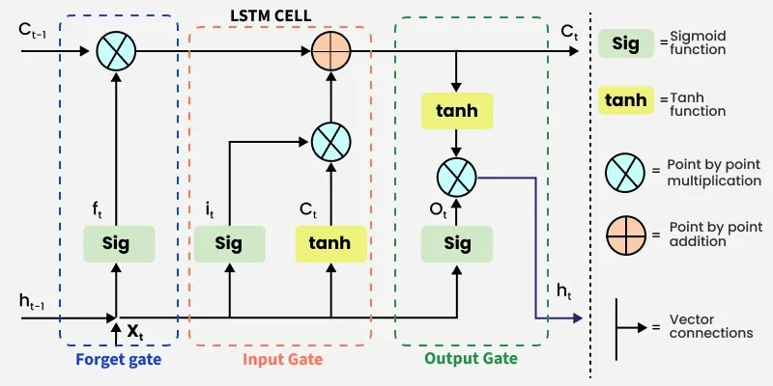
Working of LSTM LSTM architecture has a chain structure that contains four neural networks and different memory blocks called cells.

Slide 9
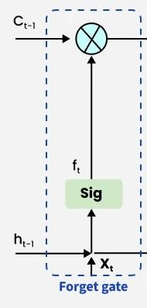
Working of GATES
Forget GATE
Purpose: To identify and remove information from the cell state that is no longer deemed useful.
Inputs: It receives two inputs at the current time step:
xt​: The current input to the LSTM unit.
ht−1​: The hidden state output from the previous time step.
Process:
The inputs xt​ and ht−1​ are concatenated into a single vector [ht−1​,xt​].
This concatenated vector is multiplied by a weight matrix specific to the forget gate, Wf​.
A bias vector, bf​, is added to the result of the multiplication.
The resulting vector is then passed through a sigmoid activation function, σ.
Output: The output of the forget gate, ft​, is a vector of values between 0 and 1.
A value close to 0 indicates that the corresponding information in the previous cell state should be forgotten (removed).
A value close to 1 indicates that the corresponding information should be retained for future use.
Equation: The operation of the forget gate is mathematically represented as:
ft​=σ(Wf​⋅[ht−1​,xt​]+bf​)
This gate plays a crucial role in allowing the LSTM to selectively remember and forget information, which is essential for handling long-term dependencies in sequential data.

Slide 10
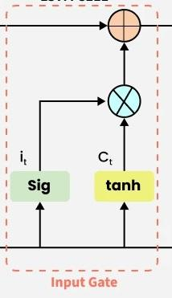
Working of GATES
Input GATE
Purpose: To control the addition of new, useful information into the cell state. This involves two main steps: filtering relevant information and generating candidate updates.
Inputs: Similar to the forget gate, the input gate receives:
x_{t}​: The current input to the LSTM unit.
h_{t−1​}: The hidden state output from the previous time step.
Process:
Filtering Relevant Information:
The inputs x_{t} and h_{t−1​} are concatenated: [h_{t−1​}, x_{t} ].
This concatenated vector is multiplied by a weight matrix specific to the input gate, W_{i}​.
A bias vector, bi​, is added to the result.
The result is passed through a sigmoid activation function, σ, producing the input gate's output, it​. This it​ acts as a filter, determining which candidate values should be considered for updating the cell state. Values in it​ close to 1 indicate that the corresponding candidate information should be added, while values close to 0 suggest it should be ignored.
The equation for this filtering step is: i_{t}​=σ(W_{i}​⋅ [h_{t−1​}, x_{t} ]. +b_{i})

Slide 11
Working of GATES
Input GATE
Generating Candidate Cell State Values:
The same concatenated input vector [h_{t−1​}, x_{t} ]is multiplied by another weight matrix, Wc​.
A bias vector, b_{c}​, is added to this product.
The result is then passed through a hyperbolic tangent activation function, tanh, producing a vector of candidate cell state values, C^_{t}​. The tanh function outputs values between -1 and +1, representing potential updates to the cell state.
The equation for generating the candidate cell state is: C^_{t}​=tanh(Wc​⋅ [h_{t−1​}, x_{t} ] +b_{c})
Updating the Cell State:
The previous cell state, C_{t−1​}, is element-wise multiplied (denoted by ⊙) with the output of the forget gate, ft​. This step discards the information that the forget gate deemed irrelevant.
The candidate cell state values, C^_{t}​, are element-wise multiplied with the output of the input gate, it​. This scales the candidate updates based on the input gate's decision of what new information is important.
Finally, these two results are added together to produce the new cell state, C_{t}. This new cell state now incorporates the retained information from the past and the newly added relevant information.
The equation for updating the cell state is : C_{t} =f_{t}⊙ C_{t} −1​+i_{t}​⊙C^_{t}​
In essence, the input gate works in conjunction with the candidate cell state to selectively introduce new information into the LSTM's long-term memory (the cell state), while the forget gate simultaneously manages the removal of outdated information. This careful regulation allows the LSTM to learn and retain relevant information over extended sequences.

Slide 12
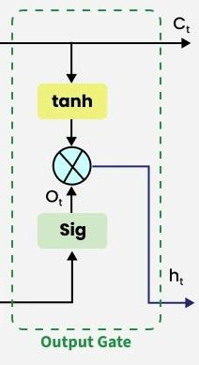
Working of GATES
The output gate in an LSTM unit is responsible for determining what information from the current cell state should be exposed as the output of the LSTM block at the current time step (h_{t}) and also be passed as the hidden state to the next time step. Here's a breakdown based on your description:
Purpose: To extract and filter useful information from the current cell state (C_{t}​) to produce the output (h_{t}).
Inputs: Similar to the input and forget gates, the output gate receives:
x_{t}: The current input to the LSTM unit.
H_{t-1}​: The hidden state output from the previous time step.
Process:
Filtering Based on Input and Previous Hidden State:
The inputs x_{t} and H_{t-1} are concatenated: [h_{t-1},x_{t}].
This concatenated vector is multiplied by a weight matrix specific to the output gate, W_{o}​.
A bias vector, b_{o}, is added to the result.
The result is passed through a sigmoid activation function, σ, producing the output gate's activations, O_{t}​. This ot​ acts as a filter, deciding which parts of the cell state will be outputted. Values in O_{t}​ close to 1 indicate that the corresponding information in the cell state should be outputted, while values close to 0 suggest it should be suppressed.
The equation for this filtering step is: O_{t}​​=σ(W_{o} ⋅ [h_{t-1},x_{t}]+ b_{o})

Slide 13
Working of GATES
Preparing the Cell State for Output:
The current cell state, C_{t}, is passed through a hyperbolic tangent activation function, tanh. This squashes the values in the cell state to a range between -1 and +1, preparing them for modulation by the output gate.
Generating the Output (Hidden State):
The output of the sigmoid gate (O_{t}) is element-wise multiplied (⊙) with the tanh of the current cell state (tanh(C_{t})). This multiplication selectively outputs the parts of the cell state that the output gate has deemed important. The result of this multiplication becomes the current hidden state, h_{t}, which is then passed as the output of the LSTM block at the current time step and also fed as the h_{t-1}​ input to the LSTM block at the next time step.
The equation for the current hidden state (output) is: h_{t}​=O_{t}⊙tanh(C_{t})
So, the complete equation you started for the output gate is:
O_{t} ​=σ(W_{o}​⋅ [h_{t-1},x_{t}]+b_{o}​)
And the equation for the resulting hidden state (output) is:
h_{t}​=O_{t}⊙tanh(C_{t})
The output gate is crucial for controlling what the LSTM exposes to the rest of the network at each time step, allowing it to make predictions based on the relevant information it has stored in its cell state.

Slide 14
Bidirectional LSTMs
Bidirectional LSTMs enhance the capability of standard LSTMs by processing sequential data in both forward and backward directions.
Motivation: This bidirectional processing enables the model to capture longer-range dependencies more effectively than traditional unidirectional LSTMs, as it can consider context from both past and future time steps for any given point in the sequence.
Architecture: A BiLSTM consists of two parallel LSTM networks:
One LSTM processes the input sequence in the standard forward direction (from the beginning to the end).
The other LSTM processes the reversed input sequence (from the end to the beginning).
Output Combination: The outputs generated by the forward and backward LSTM networks at each time step are then combined (e.g., through concatenation, addition, or averaging) to produce the final output for that time step. This combined output encapsulates information from both past and future contexts.
Performance: BiLSTM models, along with standard LSTMs, have achieved state-of-the-art performance in various sequence-related tasks, including machine translation, speech recognition, and text summarization, highlighting their effectiveness in understanding complex sequential patterns.
Stacking: Like regular LSTMs, BiLSTMs can also be stacked to create deeper models. Each layer in a stacked BiLSTM can learn increasingly complex and hierarchical representations of the temporal relationships within the data.

Slide 15
Applications of LSTM
Some of the famous applications of LSTM includes:
Language Modeling: Used in tasks like language modeling, machine translation and text summarization. These networks learn the dependencies between words in a sentence to generate coherent and grammatically correct sentences.
Speech Recognition: Used in transcribing speech to text and recognizing spoken commands. By learning speech patterns they can match spoken words to corresponding text.
Time Series Forecasting: Used for predicting stock prices, weather and energy consumption. They learn patterns in time series data to predict future events.
Anomaly Detection: Used for detecting fraud or network intrusions. These networks can identify patterns in data that deviate drastically and flag them as potential anomalies.
Recommender Systems: In recommendation tasks like suggesting movies, music and books. They learn user behavior patterns to provide personalized suggestions.
Video Analysis: Applied in tasks such as object detection, activity recognition and action classification. When combined with CNN they help analyze video data and extract useful information.

Slide 16
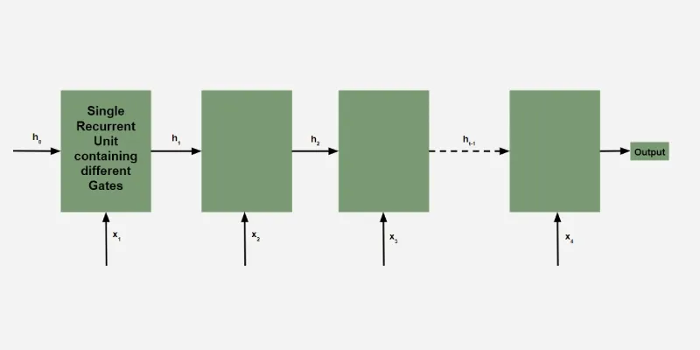
Gated Recurrent Units (GRUs)
LSTMs are powerful, their complex architecture does come with a significant computational cost. This is where Gated Recurrent Units (GRUs) come into play as a more streamlined and often more computationally efficient alternative.
GRUs were introduced by Cho et al. in 2014 with the primary goal of achieving similar performance to LSTMs on many sequential tasks while having a simpler structure and thus a lower computational overhead.

Slide 17
Gated Recurrent Units (GRUs)
The key idea behind GRUs, much like LSTMs, is the use of gating mechanisms. These gates allow the GRU to selectively update its hidden state at each time step. This selective updating enables the GRU to:
Remember important information from earlier in the sequence.
Discard irrelevant details that are no longer needed.
The main way GRUs simplify the LSTM architecture is by merging some of the gating mechanisms. Instead of the three separate gates (input, forget, and output) found in LSTMs, GRUs consolidate these into just two main gates:
Update Gate: This gate controls how much of the previous hidden state should be retained and how much of the new candidate hidden state should be incorporated into the current hidden state. It essentially decides what to keep from the past and what to update with the present.
Reset Gate: This gate determines how much of the previous hidden state should be ignored (reset) when computing the new candidate hidden state. It helps the network to forget past information that is irrelevant to the current input.

Slide 18
Gated Recurrent Units (GRUs)
By reducing the number of gates, GRUs have fewer parameters and simpler internal computations compared to LSTMs.This often translates to:
Faster training times.
Lower memory usage.
Potentially better performance on smaller datasets due to the reduced risk of overfitting.
Despite their simpler structure, GRUs have proven to be remarkably effective in a wide range of sequential tasks, often achieving comparable or even better performance than LSTMs. This makes them a popular choice when computational resources are limited or when faster training is desired without a significant drop in accuracy.

Slide 19
Working of Gated Recurrent Units (GRUs)
Reset Gate (r_{t}):
Determines the extent to which the previous hidden state (h_{t-1}) is "forgotten" or ignored when calculating the new candidate hidden state.
Inputs: Previous hidden state (h_{t-1}) and current input (x_{t}).
Process: Concatenation of inputs, multiplication by weight matrix W_{r}, application of sigmoid activation (σ).
Equation: r_{t}=σ(W_{r} ⋅[h_{t-1}, x_{t}])
Output: Values between 0 and 1. Closer to 0 means more of the past hidden state is reset.
Update Gate (z_{t}​):
Controls the degree to which the hidden state is updated with new information (x_{t}) and how much of the previous hidden state (h_{t-1}) is retained.
Inputs: Previous hidden state (h_{t-1}) and current input (x_{t}).
Process: Concatenation of inputs, multiplication by weight matrix W_{z}, application of sigmoid activation (σ).
Equation: z_{t}=σ(W_{z} ​⋅[h_{t-1}, x_{t}])
Output: Values between 0 and 1. Closer to 1 means more of the previous hidden state is retained.
These two gates, the reset and update gates, are the fundamental mechanisms that allow GRUs to selectively remember and update information, addressing the long-term dependency problem more efficiently than standard RNNs.

Slide 20
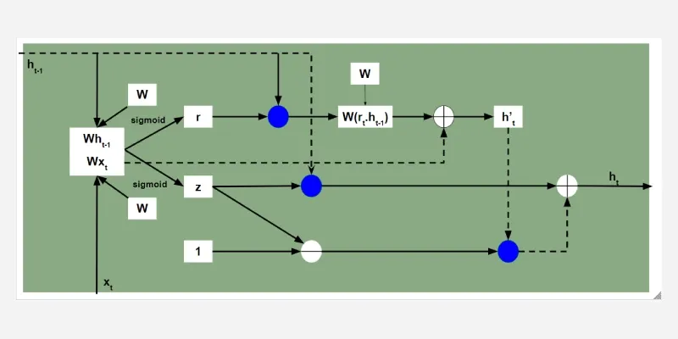
Working of Gated Recurrent Units (GRUs)

Slide 21
Working of Gated Recurrent Units (GRUs)
Candidate Hidden State (ht′​):
Represents the potential new hidden state based on the current input (x_{t}) and the reset previous hidden state (r_{t}⋅ h_{t-1}).
Inputs: Current input (x_{t}) and the element-wise product of the reset gate (r_{t}) and the previous hidden state (h_{t-1}).
Process: Concatenation of inputs, multiplication by weight matrix Wh​, application of tanh activation.
Equation: ht′​=tanh(W_{h}​⋅[r_{t}⊙ h_{t-1}, x_{t} ​])
Significance: The reset gate (r_{t}) modulates the influence of the past hidden state on the calculation of this new candidate. If r_{t} is close to 0, the candidate hidden state primarily depends on the current input, effectively "resetting" the influence of the past.

Slide 22
Working of Gated Recurrent Units (GRUs)
Hidden State (h_{t}​):
The final hidden state at the current time step is a blend of the previous hidden state (h_{t-1}​) and the candidate hidden state (ht′​​). The update gate (z_{t}) controls this blending.
Inputs: Previous hidden state (h_{t-1}), candidate hidden state (ht′​​), and the update gate (z_{t}).
Process: A weighted average where (1− z_{t}) determines how much of the previous hidden state is retained, and z_{t} determines how much of the new candidate hidden state is incorporated.
Equation: h_{t}=(1−z_{t})⊙h_{t-1}​+ z_{t} ​⊙ht′​​
Significance: The update gate (z_{t}) decides how much of the past information (from h_{t-1}) should be carried forward and how much of the newly proposed information (from ht′​)should contribute to the current hidden state.
In summary, the GRU uses the reset gate to control the influence of the past when generating a new candidate state, and the update gate to decide how to combine the past state with this candidate to form the current hidden state. This mechanism allows GRUs to learn and manage long-term dependencies effectively with a simpler structure than LSTMs.

Slide 23
GRUs Mitigate the Vanishing Gradient Problem
Gated Mechanisms: GRUs, similar to LSTMs, employ gates (update and reset) that control the flow of information and gradients through the network.
Direct Pathway for Information: The update gate (z_{t}) plays a crucial role in this mitigation. It allows the GRU to directly pass information from previous time steps into the current hidden state. If the update gate is close to 1, a significant portion of the previous hidden state is retained and carried forward.
Gradient Flow: This direct pathway for information also facilitates a more direct flow of gradients during backpropagation. Gradients can flow more easily through the update gate without being repeatedly multiplied by potentially small values (as in standard RNNs without gating mechanisms).
Preserving Long-Term Dependencies: By selectively retaining relevant information over many time steps through the update gate, GRUs ensure that the gradients associated with this important historical information are less likely to vanish. This allows the network to learn long-range dependencies more effectively.
Balancing Memory and New Information: The interplay between the update and reset gates enables the GRU to maintain a balance between remembering important past information and incorporating new, relevant data. The reset gate helps in focusing on the current input when necessary, while the update gate ensures that crucial historical context is not lost.

Slide 24
GRU Vs LSTM
Feature | LSTM (Long Short-Term Memory) | GRU (Gated Recurrent Unit)
Gates | 3 (Input, Forget, Output) | 2 (Update, Reset)
Cell State | Yes it has cell state | No (Hidden state only)
Training Speed | Slower due to complexity | Faster due to simpler architecture
Computational Load | Higher due to more gates and parameters | Lower due to fewer gates and parameters
Performance | Often better in tasks requiring long-term memory | Performs similarly in many tasks with less complexity

Slide 25
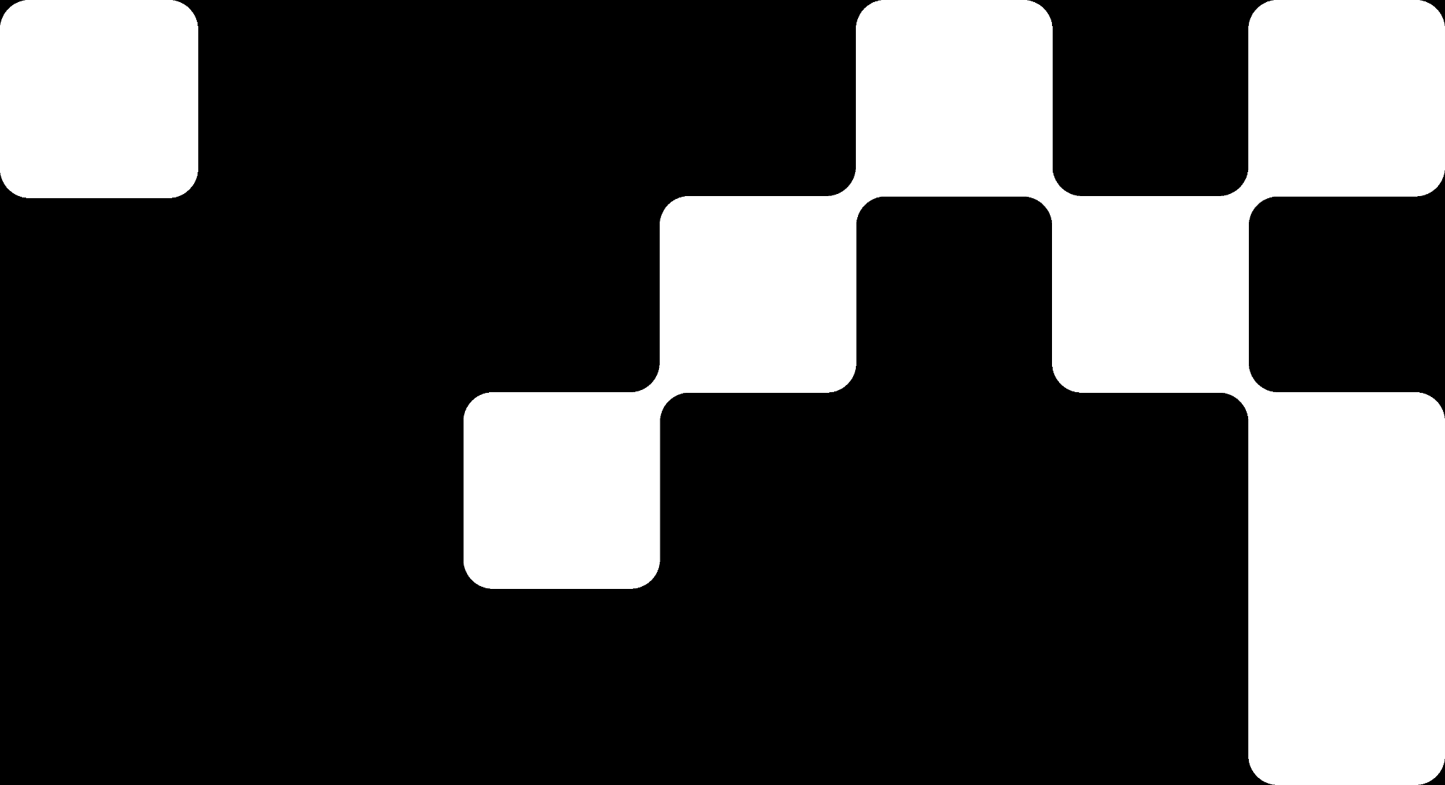

Hands On Exercise
Click Here For The Implementation on Google Colab
https://drive.google.com/file/d/1PFRcwMSE9jDkYlX5PVytRvHLOLLQpylV/view?usp=share_link

Slide 26
Books and References
"Neural Networks and Deep Learning" (Michael Nielsen)
Deep Learning for Computer Vision (Rajalingappaa Shanmugamani)
https://www.geeksforgeeks.org/gated-recurrent-unit-networks/
Goodfellow, I., Bengio, Y., & Courville, A. (2016). Deep Learning. MIT Press.
Chollet, F. (2017). Deep Learning with Python. Manning Publications.
Hochreiter, S., & Schmidhuber, J. (1997). Long Short-Term Memory. Neural Computation.

Slide 27

















الشراكات العالمية

Slide 28
شــــــكــــرًا لكــــــم
THANK YOU

